Slide 1
CSE 3100: Systems Programming
Part 4
Lecture 3: Socket Programming Protocol
Professor Kaleel Mahmood
Department of Computer Science and Engineering
University of Connecticut

Slide 2
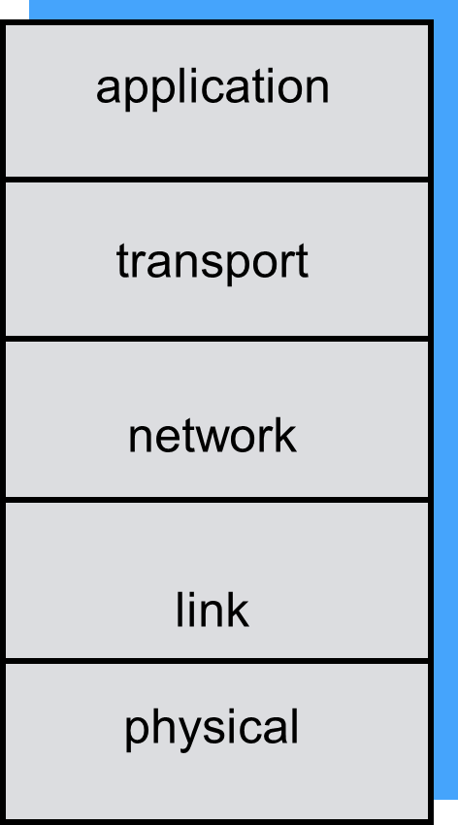
Review: How Do We Understand Networking? With Layers.
Why use layers?
Explicit structure allows identification and outlines the relationship of complex system’s pieces.
And these layers need rules for how to communicate…
Process 1
Process 2
Physical Communication Channel

Slide 3
Network Protocols 1
Process 1
Process 2
Protocol = Rules for communicating between two parties.
For every layer we will need a protocol (e.g. TCP and IP are protocols).
After establishing a TCP connection, two processes talk at application layer.
Physical Communication Channel

Slide 4
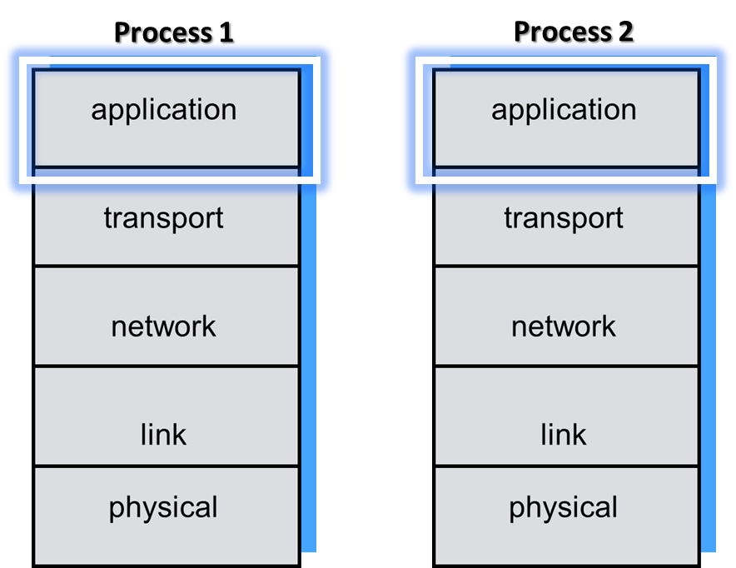
Network Protocols 2
TCP connection
After the TCP connection is established, several questions arise:
Who should talk first?
How much can each side talk?
How are the messages encoded into bytes?
It’s the job of the protocol to answer these questions/have rules for how these questions can be answered.

Slide 5
Sending Data: Byte stream in sockets
Applications see byte streams into and out of sockets.
How do the applications interpret the bytes? Two common ways:
Plain text – E.g. Extensible Markup Language (XML) or JavaScript Object Notation (JSON).
Need to account parsing and conversion.
Raw Data
Must account for two issues, endianness and padding.

Slide 6
Example Sending Problem
TCP connection
int v = 128;
Consider the case where process 1 and 2 are connected via TCP/Ip and process 1 now wants to send variable v with value 128 to process 2.
How can this be accomplished?
Plain Text - three ASCII characters with a delimiter: '1', '2', '8', '\n’
Raw Data - four bytes: 0x00, 0x00, 0x00, 0x80 (or 0x80, 0x00, 0x00, 0x00?)

Slide 7
Byte Ambiguity
Imagine that we get the following stream of bytes (remember a byte is 8 bits):
First Byte:
Second Byte:
Third Byte:
00000000
00000000
10000000
Now we want to reconstruct this as a number. How can we do it?
Option A: Assume that the first byte is the MOST significant so the number becomes:
First Byte:
Second Byte:
Third Byte:
00000000
00000000
10000000
In decimal: 128
00000000 00000000 10000000

Slide 8
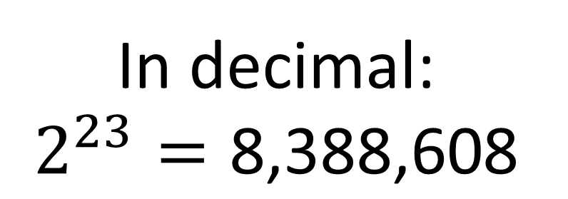
Byte Ambiguity 2
First Byte:
Second Byte:
Third Byte:
00000000
00000000
10000000
Option B: Assume that the first byte is the LEAST significant so the number becomes:
Third Byte:
Second Byte:
First Byte:
10000000
00000000
00000000
In decimal:
$$2^{23}=\text{8}\text{,}\text{388}\text{,}\text{608}$$
10000000 00000000 00000000

Slide 9

First Byte:
Second Byte:
Third Byte:
00000000
00000000
10000000
So is our number 8 million or 128?

Slide 10
Solution: Endianness
Endianness - is the order or sequence of bytes of a word of digital data.
Two ways:
A big-endian system = stores the most significant byte of a word at the smallest memory address and the least significant byte at the largest. First byte received is the most significant.
A little-endian system= Stores the least-significant byte at the smallest address. First byte received is the least significant.
Important takeaway: Both parties need an agreement to interpret the bytes with the same ordering.
Source: https://en.wikipedia.org/wiki/Endianness

Slide 11
Endianness Example
Bytes: 128(0x80), 41(0x29), 12(0x0C), 217(0xD9)
Higher mem address
Big-Endian
128
41
12
217
Little-Endian
217
12
41
128

Slide 12
Change byte ordering for 16-bit or 32-bit integers
#include <arpa/inet.h>
uint32_t htonl(uint32_t hostlong);
uint16_t htons(uint16_t hostshort);
uint32_t ntohl(uint32_t netlong);
uint16_t ntohs(uint16_t netshort);
Two orderings may not be the same:
Host Byte Ordering platform dependent
Network Byte Ordering always big-endian
The htonl() function translates a long integer from host byte order to network byte order.
Convert to network byte ordering before sending.
Convert to host byte ordering after receiving.
htonl and ntohl for 32-bit. htons and ntohs for 16-bit

Slide 13
Side Note: Sending a String
We are fine in this course because we assume ASCII strings
Each character has only one byte.
In the real word, modern applications assume Unicode internally
Especially important for web servers
Your customers/users speak many kinds of languages!
Example:
Python 3 uses Unicode strings by default
"♡♫".encode('utf-8') # encode a string to byte array using UTF-8
data.decode('utf-8') # decode a byte array using UTF-8 to a string

Slide 14
What were the issues with sending raw data?
Endianness – use the appropriate conversion functions like “htonl” before/after sending bytes.
Padding/Alignment

Slide 15

Issues with structure: alignment and padding
Imagine after connecting, the client sends data and the server copies into memory. Assume the data is sent in raw form (bytes):
Information sent by client:
Structure to be filled in by banking server:
1234
Bill Baker
500
TCP connection
Customer ID
First Name
Balance
Everything OK with this setup?
All Good

Slide 16
Issues with structure: alignment and padding
Now the client decides to also include their phone number as an additional piece of data:
Information sent by client:
Structure to be filled in by banking server:
1234
Bill Baker
8604863331
500
TCP connection
Customer ID
First Name
Balance
Everything OK with this setup?
Not Good

Slide 17

Solutions to the alignment problem
For sending raw data:
Use explicit padding (or reorder fields).
Make sure server/client code matches.
However even with correct alignment if the server and client have different architectures (e.g. 32 bit vs 64 bit) problems are possible with language/machine dependent data/structures.
Is there any better solution?
JSON

Slide 18
Solutions to the alignment problem 2
Solution: Don’t send data.
Don’t send raw data. Use a markup language for sending data.
Two popular ways to do this are Extensible Markup Language and JavaScript Object Notation.
Going back to our previous example, how would we write that in XML?
<customerinfo>
<id>1234</id>
<fname>BillBaker</fname>
<balance>500</balance>
</customerinfo>
1234
Bill Baker
500

Slide 19
The XML Solution
Now what will happen if in XML we add in the extra field telephone number and send it?
Information sent by client:
XML Solution:
The server code is designed to extract data between the tags.
If the tag doesn’t match the description of what the server is looking for then it is ignored.
Tags are case sensitive.
<customerinfo>
<id>1234</id>
<fname>BillBaker</fname>
<balance>500</balance>
<telephone>8604863331</telephone>
</customerinfo>
What does JSON look like?

Slide 20
The JSON Solution
JSON syntax is slightly different and uses (key, value) pairs:
1234
Bill Baker
500
{‘id’: 1234, ‘fname’: ‘BillBaker’, ‘balance’: 500}
Denotes the start of a record.
Denotes the end of a record.
Similar to the XML solution, the server code should be designed to read the keys. If a key like ‘fname’ is not needed, then it is ignored.

Slide 21
XML VS JSON
XML
JSON
<customerinfo>
<id>1234</id>
<fname>BillBaker</fname>
<balance>500</balance>
</customerinfo>
{‘id’: 1234, ‘fname’: ‘BillBaker’, ‘balance’: 500}
What can you notice about the amount of characters between the two?
JSON uses less, therefore it is more efficient for data transfer. Although XML was invented first, JSON has been gaining popularity.
Both provide high reliability in data exchange.

Slide 22
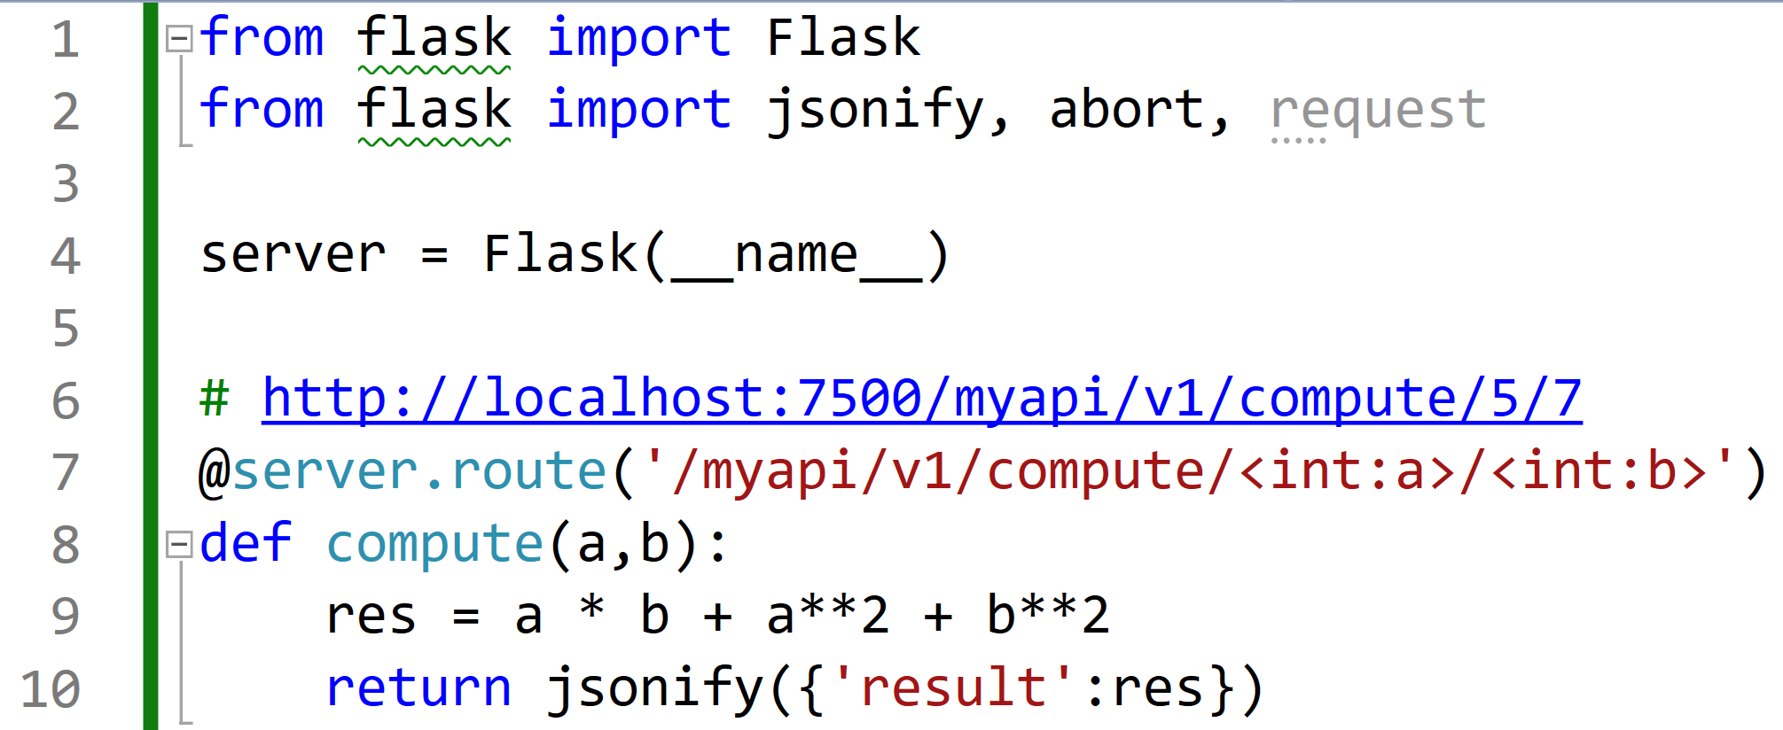
Coding Example: Creating a Server and using JSON in Python
Note: I will not test you on Python client-server coding.
We’ll use a web service library in Python: Flask

Slide 23
Basic import statements

Slide 24
Create the server as a global variable without specifying port number or IP yet.
These will be filled in later.
The name input is needed for some internal setup with the flask library.

Slide 25
Have the server do some basic computation for the client. In this case the server takes two numbers from the client a and b.
The computation is returned as a JSON result.
How can the client access this service?

Slide 26
How can the client access this service?
This special syntax allows the client in a (web address bar) to type this string with numbers ‘a’ and ‘b’ to access this function from the server.

Slide 27
Full method looks like with code for the client to call the method:

Slide 28

How do we actually setup the server in Python?
It is extremely challenging and takes years of practice to accomplish.
We will need to cover a lot of theory before you are ready.

Slide 29
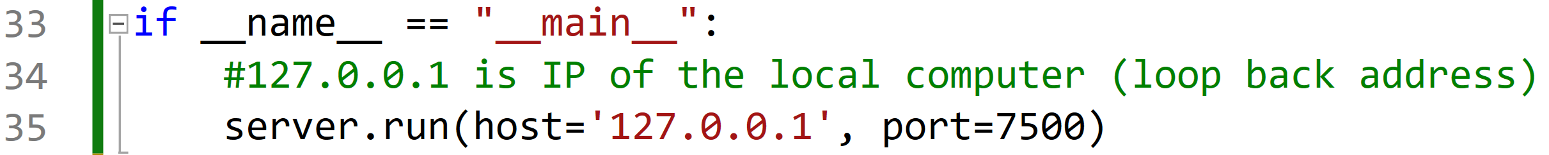
Just kidding: only one line…
Set the IP address of the server to be the internal IP address so we can access it for this demo.
Choose a port number

Slide 30
Coding Demonstration

Slide 31

Coding
client-server in Python
3100 class forced to code
client-server in C:
Does this mean we should never use C for client-server setups?

Slide 32
C and Python Server Setup
As can be seen from the Python coding demonstration, setting up a server is extremely simple in Python with the Flask library.
Does that mean you should always use Python on the job?
NO. You need to consider functionality. C client servers may be difficult to setup but that is because they offer fine grained control.
Does this mean you should always use C on the job?
NO. Sometimes you need a quick and dirty implementation to prototype a feature or check basic functionality. Then Python may be favorable.
Your choice should largely depend on application.

Slide 33
Types of Servers
In the first part of this lecture we saw a client server setup.
Using Python we saw another type of server:
1. Web Server (hosting some API)
Other type of servers exist including:
2. Simple Mail Transfer Protocol (SMTP) Server
This type of server is used to request emails to be sent on your behalf. E.g. connect to Google’s SMTP server to send email to a customer.
3. Trivial File Transfer Protocol Server

Slide 34
Trivial File Transfer Protocol (TFTP)
Server waits for commands and performs operations accordingly
Client sends a command to the server and waits for the response
Three commands are supported
LS List files in the directory on the server side
GET fn Download a file named “fn” from the server
EXIT End the session
How to encode the command, messages, and files?

Slide 35
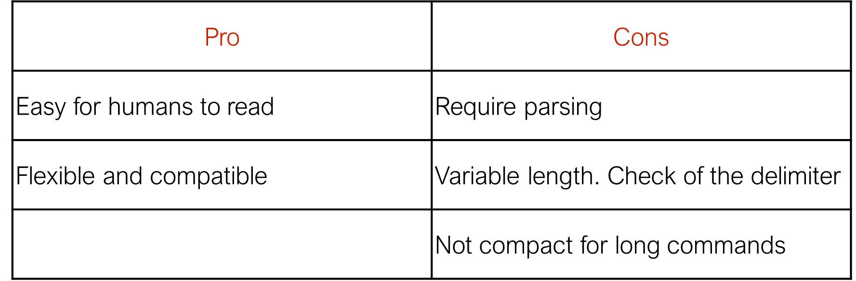
Command Options: Text
A command is an ASCII string ending with a delimiter, e.g., '\n'
Both parties have to agree on the delimiter
Example: GET(fn)
send_str("get hello.txt\n"); // no need to send NUL

Slide 36
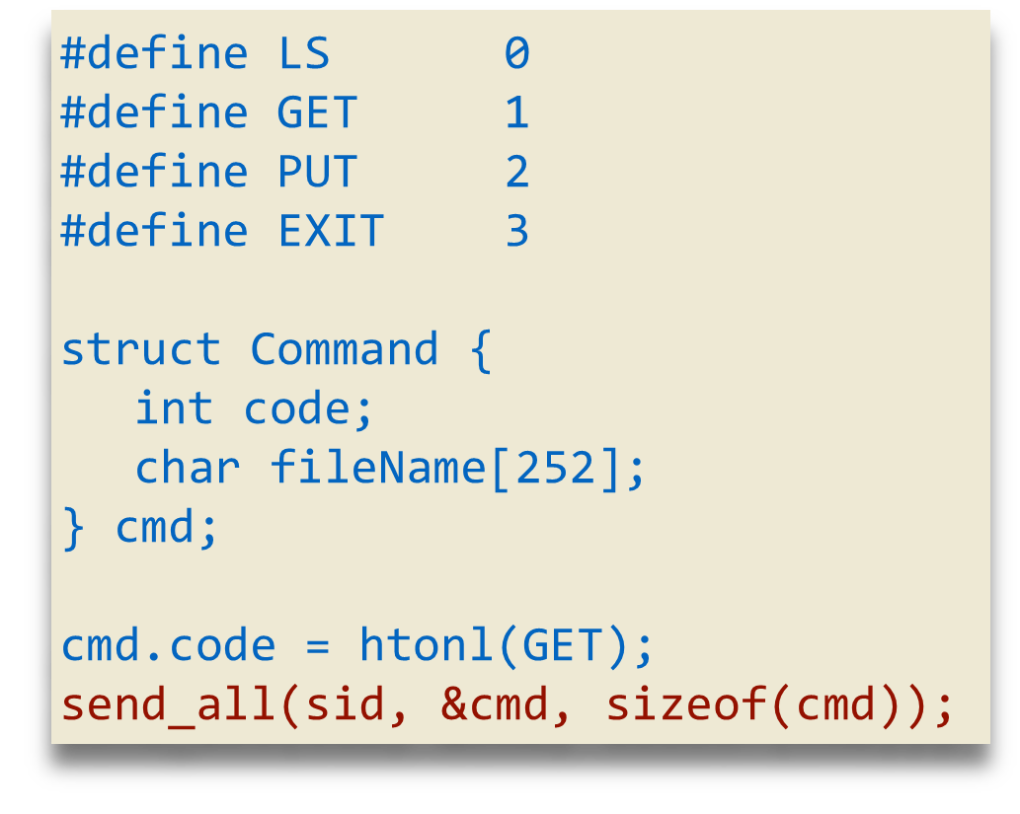
Command Options: Binary, fixed size
A command is represented by a structure
All commands have the same size (good or bad?)
Example:
Pro | Cons
Nothing to parse | Hard to read and maintain
Fixed size | Fixed size
 | Endianness
 | Padding

Slide 37
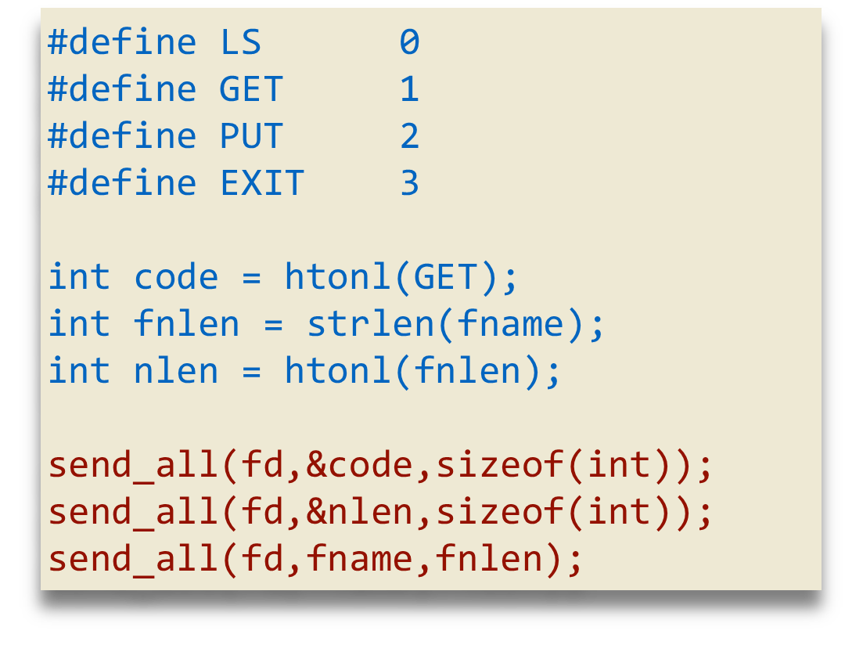
Command Options: Dynamic size
LS and EXIT need only 4 bytes (or we can use only one byte)
GET needs to send additional (filename length + 4) bytes
Pro | Cons
Nothing to parse | Hard to read and maintain
Dynamic sizing | Endianness
 | More brittle

Slide 38
Admin Stuff
No homework 9. Hooray!
There is a lab 9 this week. Boo!
Next week Monday we will do the practice exam 3.
Next week Wednesday we will go over exam 3 answers.
Exam 3 will again be a combination of coding and multiple choice.
Students who need CSD accommodations should email for joining the special session hosted by the TAs on Friday.

Slide 39
Figure Sources
https://media.istockphoto.com/id/91520053/photo/senior-man-shrugging-shoulders.jpg?s=612x612&w=0&k=20&c=x9iR8Az32VZwE0VOlu9s30Urp8HunhuwfBN2RmFCytg=
https://wompampsupport.azureedge.net/fetchimage?siteId=7575&v=2&jpgQuality=100&width=700&url=https%3A%2F%2Fi.kym-cdn.com%2Fphotos%2Fimages%2Fnewsfeed%2F002%2F223%2F493%2F57e.jpg
https://i.imgflip.com/2odtfu.jpg?a467160
https://i.pcmag.com/imagery/articles/05bPZDk51kgPAHXjy1itj1t-1.fit_lim.v1647613226.jpg

